Slide 1
CSS Absolute Positioning & Z-Index

Slide 2
CSS-Positioning
The first rule of using CSS-P to layout a whole page is to put all content in <div>s.
You don't have to put the whitespace between the boxes in <div>s, but all content must be placed in a box.
Always code your layout before you add your content. This makes debugging and adjusting the layout a breeze.
As you gain experience, you can jump right into coding these layouts, but to start out, calculate your dimensions and positions first.

Slide 3
Ways of positioning
If you want to position an element you have to specify not just a set of coordinates that say where you want it to be, you also have to specify what these coordinates are with respect to.
The position property is used to determine what the coordinates are with respect to, or how the element will be drawn.
Simply assign the position property one of four keywords: static, relative, absolute and fixed.
The actual position (the where) is specified using the top, left, bottom and right properties.

Slide 4
Four basic ways to position an element box:
static: leave it in the flow
by default elements will display in their order in the .html page
absolute: remove it from the normal flow and specify exact coordinates with respect to it's viewport/parent (explained later).
fixed: remove it from the flow and specify exact coordinates with respect to the browser window.
relative: move the box with respect to it's default position in the flow (where it should normally appear).

Slide 5
Static (default) positioning
Static, or normal positioning is the default. If you don't specify a position: value for an element, consider that it is static - in essence, the element appears exactly where it was typed in the code.
Source Code - -position_static.html

Slide 6
Absolute Positioning
When you specify position:absolute, the element is removed from the page flow entirely and placed exactly where you tell it to go.
Allows other elements to flow into the space the element would have occupied
Location is calculated relative to closest ancestor element that has position applied to it
Note:
Use percentages to create "liquid layouts"
Since absolute elements are taken out of the flow they can overlap
Positioning is not inherited
At the highest level an element is nested within the <body>

Slide 7
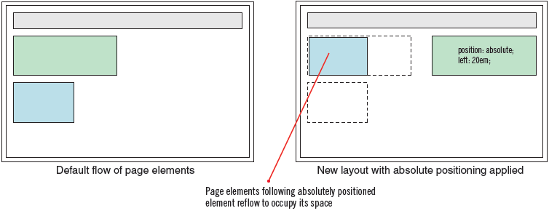
Absolute positioning and page flow

Slide 8
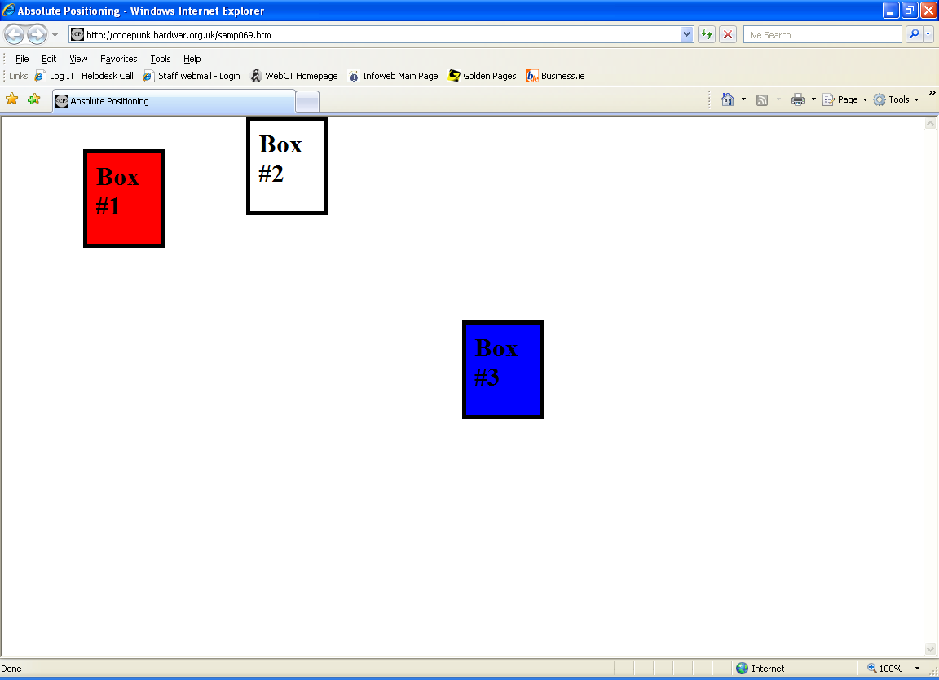
Absolute Positioning (continued)
We'll be making the following example to start.

Slide 9
Absolute Positioning (continued)
You should be able to make and style the boxes. Below is the code for the styling of the red box:
#box1{ width: 100px; height: 100px; padding: 10px; border: 5px solid #000000; background-color: #ff0000; color: #000000; }

Slide 10
Absolute Positioning (continued)
We want to absolutely position this box on the page so we need to declare "position: absolute".
#box1{ position: absolute; width: 100px; height: 100px; padding: 10px; border: 5px solid #000000; background-color: #ff0000; color: #000000; }

Slide 11
Absolute Positioning (continued)
Now we can set coordinates to place that box anywhere we want on the page.
We place the box by determining where we want to place the top-left corner of the box. We use the "top:" and “left:" properties to do this.
#box1{ position: absolute; top: 40px; left: 100px; width: 100px; height: 100px; padding: 10px; border: 5px solid #000000; background-color: #ff0000; color: #000000; }
This is what places the red box in our example 40 pixels down from the top of the screen, and 100 pixels to the right of the left edge of the screen.

Slide 12
Absolute Positioning (continued)
Can you now create the white and blue box ?

Slide 13
Using Percentages & Negative Numbers
You don't have to use specific pixel coordinates. Most browsers support the use of percentage values for "top:" and "left:". This can come in really handy when you want your page to look proportionately the same despite the viewer's monitor's resolution.
Lets say the red box in our example uses left: 50%; to place the left side of the box half way across the screen. Mind you, this isn't centering because it's the left side of the box that's being placed half way out.

Slide 14
Absolute Positioning (continued)
You can center a box by using percentages to size its "width:" and position its "left:".
Say we've got a box that's 20% of the screen wide with "left: 50%".
To "straddle" the 50% mark with the 20% box, we just divide the width by 2 which gives us 10%. Now we subtract this from the 50% center-line leaving us with 40%. Now just use "width: 20%" and "left: 40%". This will "pull" the box 10% to the left and center it.
The above takes a little figuring and practice. Remember that both the box's "width:" and "left:" must be percentage values to do this. You can align the center with any vertical or horizontal position on the screen using this method.

Slide 15
Absolute Positioning (continued)
Again most browsers support the use of "right:" and "bottom:" as well as "left:" and "top:". They work backwards from "left:" and "top:".
If you use:
bottom: 0; right: 0;
You'll get a box at the lower right corner of the page. Positive numbers move your box up and left, not down and right like with "left:" and "top:"

Slide 16
top
The top property specifies where the top of an element will be placed.
Remember, though, to position an element you must also specify a value for its position property.
top is an offset from either
the top edge of the natural location of the element (for position: relative)
the top of the parent element (for position: absolute)
the top of the window (for position: fixed)

Slide 17
left
The left property specifies where the left of an element will be placed.
Remember, though, to position an element you must also specify a value for its position property.
left is an offset from either
the left edge of the natural location of the element (for position: relative)
the left of the page or the left of the parent element (for position: absolute)
the left of the window (for position: fixed)

Slide 18
Height and Width
You can specify the size an element will occupy on the page with height and width
Notes
Percentages are relative to the size of parent elements
Padding, borders, and margin are not included in the value of width
The default width (auto):
for block level elements is width of the parent ("containing block")
if you manually set width, margin-left, and margin-right values, and their total does not equal the containing block, margin-right will be changed to auto.
you can override this default, by setting margin-left to zero
you can set both margins to zero and they will have equal maximum values, thus centering an element.

Slide 19
Stacking Elements
Stacking elements: positioning two elements so that they can overlap on a Web page
Additional possibilities for layouts
Applies only to positioned element
Requires careful planning
Stacking order controlled by values assigned to z-index property
The z-index controls what is layered on top of what regardless of the order of the code
The z-index property is set to a numerical value like "2" or "3" and such
The bigger the number, the closer to the top a box is displayed.

Slide 20
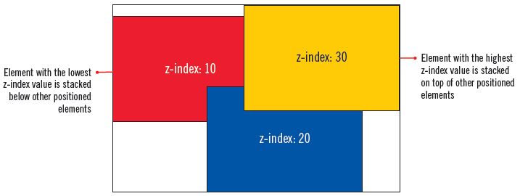
Stacking Elements(continued)

Slide 21
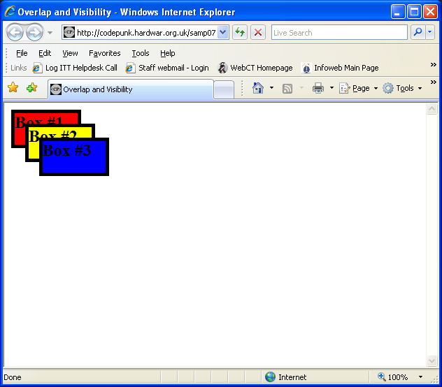

Slide 22
Stacking Elements(continued)
We've got three boxes that overlap each other.
When a browser sees that two or more boxes share some space, it always puts the last box coded on top.
This goes back to the idea that browsers render your code from top to bottom. First coded, first rendered. Last coded, last rendered.
We can change this default layering with CSS. It's not always convenient or possible to change the order of the page's code.
Lets use this to reverse the layering of the boxes by adding the following to the example's styling:
#box1{z-index: 3;} #box2{z-index:2;} #box3{z-index: 1;}
This would put box #1 on top because its "z-index:" is higher than the other boxes. box #3 would be at the bottom because it has the lowest "z-index:"

Slide 23
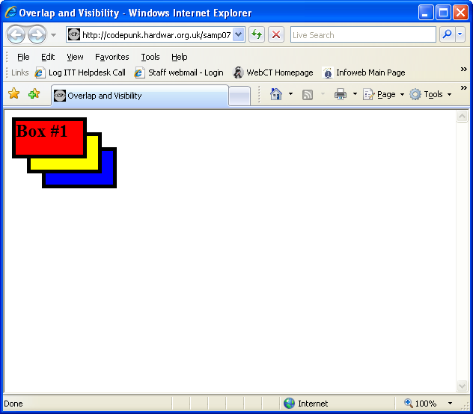

Slide 24
Keep this rule of thumb firmly in mind:
Whenever you use absolute positioning don’t try to position everything. To achieve a good layout, you usually have to use absolute positioning on only a couple of page elements.
Here’s a simple technique you can use to figure out which elements need positioning:
Say you want to build a three-column design, like Figure 13-9, right. First, study how the different sections of the page follow the normal HTML flow, without any CSS positioning (Figure 13-9, left). Then, for each layout element on your page, ask yourself, “Would this be in the right place if I didn’t position it at all?”

Slide 25
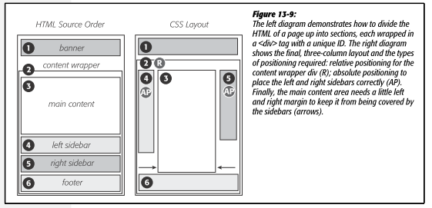
Keep this rule of thumb firmly in mind:

Slide 26
Keep this rule of thumb firmly in mind:
The banner.
The banner (1) is at the top of the page. That’s right where you want it, so it doesn’t require absolute positioning. You can use a combination of margins and padding to scoot the content around a little (maybe add some white space above or to the left of the banner).
The content wrapper.
This <div> is a special element that holds all other elements. Since it holds the page’s contents, just ask yourself whether you want the contents to appear below the banner. You do, so you don’t need to apply absolute positioning here either.
The main content.
The main part of the page is also directly under the banner (3). You’ll have to indent it on the left and right sides to make room for the sidebars, but you don’t need absolute positioning to do that.

Slide 27
Keep this rule of thumb firmly in mind:
The left sidebar.
In Figure 13-9, left, it appears way down the page underneath the main content (4). Is that where it should be? Definitely not, so this section needs absolute positioning.
The right sidebar.
Instead of appearing on the right as its name implies, this one (5) appears way down the page below the left sidebar. Here again, you need absolute positioning to put this element in its rightful place—under the banner and on the right side of the page.
The footer.
In the left image, the footer appears at the bottom of the page (6) just where you want it, so no need for any special positioning.

Slide 28
Keep this rule of thumb firmly in mind:
Note: It’s usually a bad idea to use absolute positioning to place a footer at the bottom of the browser window. If the page’s content runs longer than the height of the browser window, then the footer scrolls along with—and rides on top of—other page elements when your visitor scrolls. A better solution is fixed positioning.

